Slide 1
Licence Plate Detection
Devansh Awasthi (ENG17CS0065)
Deepak Purohit (ENG17CS0062)
BVM Anirudh (ENG17CS0048)

Slide 2
Introduction
Traffic control and vehicle owner identification has become major problem in every country.
Sometimes it becomes difficult to identify vehicle owner who violates traffic rules and drives too fast.
Therefore, it is not possible to catch and punish those kinds of people because the traffic personal might not be able to retrieve vehicle number from the moving vehicle because of the speed of the vehicle.
So, there is a need to develop License Plate Recognition system as a one of the solutions to this problem.

Slide 3
License plate recognition is a technology that uses optical character recognition on images to read vehicle registration plates to create vehicle location data.
It can use existing closed-circuit television, road-rule enforcement cameras, or cameras specifically designed for the task.
It is used by police forces around the world for law enforcement purposes, including to check if a vehicle is registered or licensed.
It is also used for electronic toll collection on pay-per-use roads and as a method of cataloguing the movements of traffic, for example by highways agencies.

Slide 4
Elements Of Number Plate Recognition
Camera - that take the images of the car (front or rear side).
Illumination - a controlled light that can bright up the plate, and allow day and night operation. In most cases the illumination is Infrared (IR) which is invisible to the driver.
Frame grabber - an interface board between the camera and the PC, allows the software to read the image information.
Computer - normally a PC running Windows or Linux. It runs the Licence Plate Recognition application which controls the system, reads the images, analyzes and identifies the plate, and interfaces with other applications and systems.

Slide 5
Software - the application that can run recognition package.
Visual Studio Code
Python modules like numpy,math,opencv,random,matplotlib
Hardware - various input/output boards which can be used to interface the external world (such as control boards and networking boards).
Database - the events are recorded on a local database or transmitted over the network. The data includes the recognition results and (optionally) the vehicle or driver-face.

Slide 6
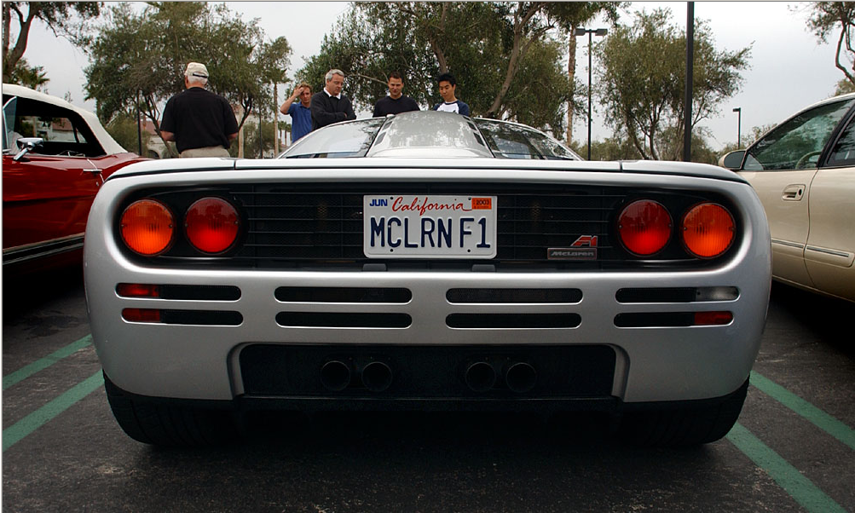
Working Of Licence Plate Detection
Step1: Input Image

Slide 7
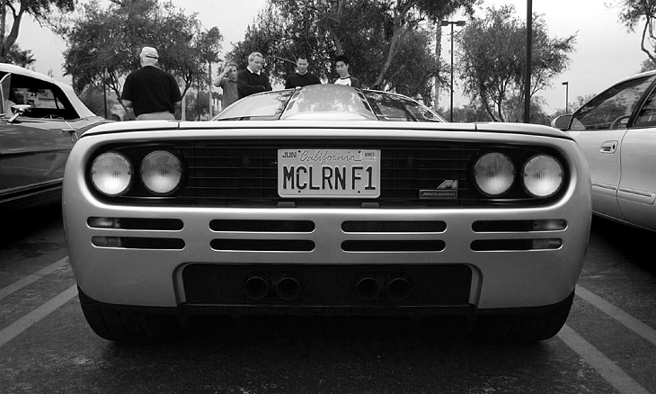
Step2: Preprocessing
(a) Gray Scale Image

Slide 8
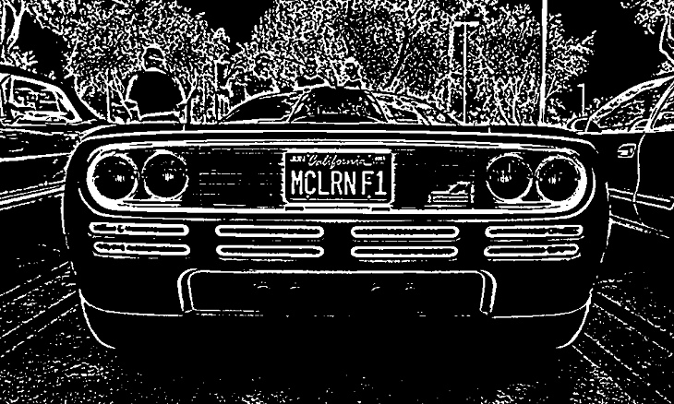
(b) Threshold Image

Slide 9
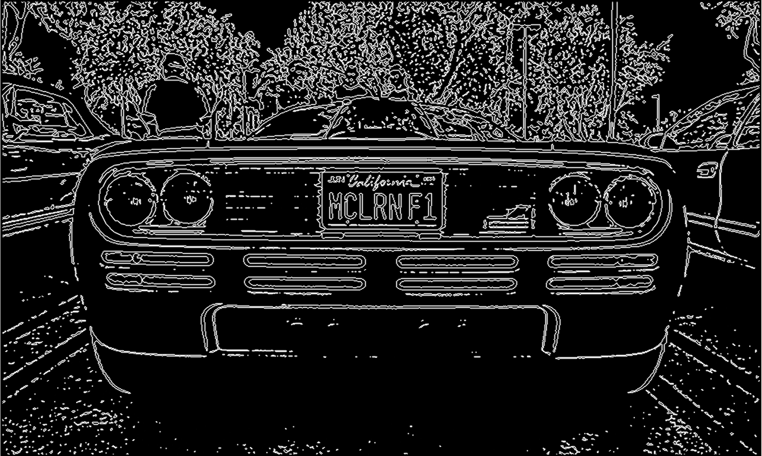
Step 3: Search for Characters in Threshold Image (Character Detection)

Slide 10
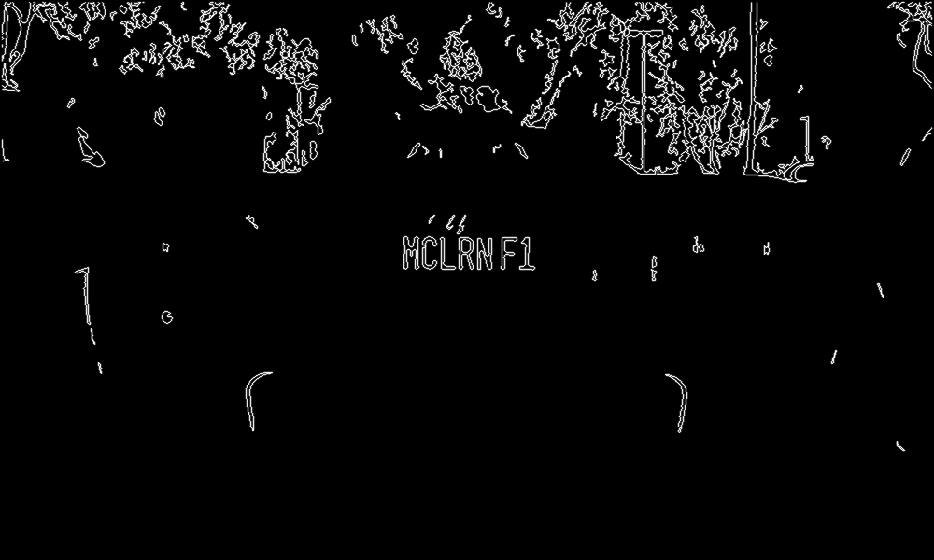
Step 4: Vectors of possible characters in Image

Slide 11
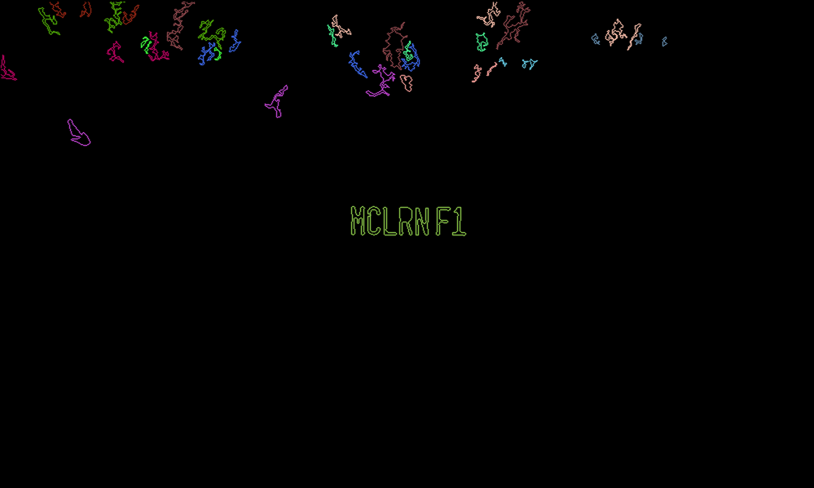
Step 5: Detect Vector of Matching Characters from Image

Slide 12
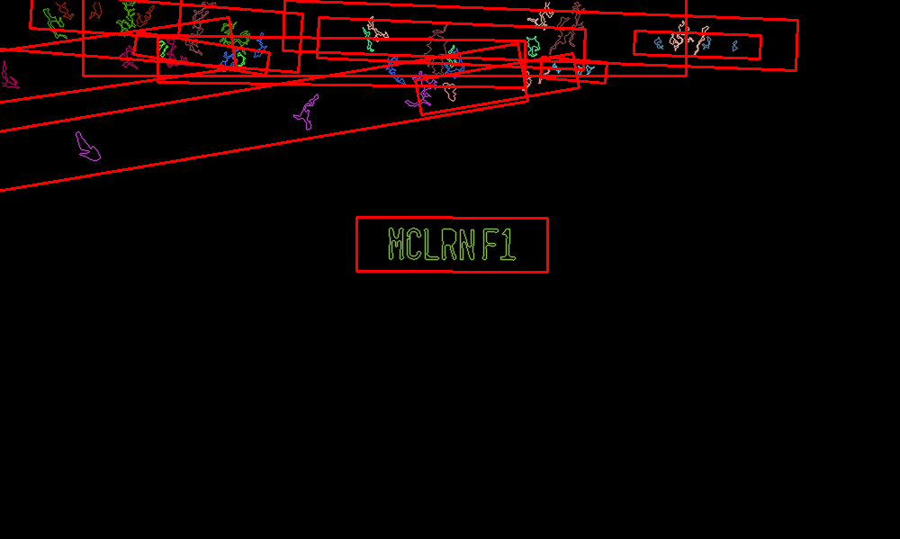
Step 6: Vector of Possible Plates (Plate Detection)

Slide 13

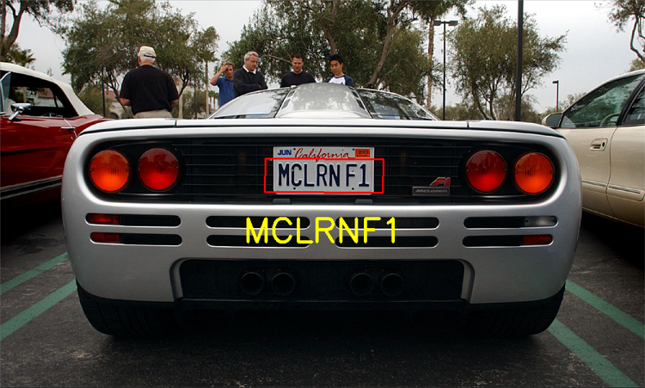
Step 8: Final Output
Step 7: Final Plate obtained after removing unwanted Plates

Slide 14
KNN Algorithm
k-nearest neighbor algorithm is a method for classifying objects based on closest training examples in the feature space.
k-nearest neighbor algorithm is among the simplest of all machine learning algorithms.
Training process for this algorithm only consists of storing feature vectors and labels of the training images.
After extracting features from both testing and training images, we converted vector represented patches into codewords. To do this we perform k means clustering over all the vectors.
k-means clustering is a method to cluster or divide n observations or, in our case, features into k clusters in which each feature belongs to the cluster of its nearest mean.

Slide 15
Applications
Parking:
One of the main applications of automatic number plate recognition is parking automation and parking security: ticketless parking fee management, parking access automation, vehicle location guidance, car theft prevention, "lost ticket" fraud, fraud by changing tickets, simplified, partially or fully automated payment process, among many others.
Border Control:
Border Control is an established state-coordinated effort to achieve operational control of the country's state border with the priority mission of supporting the homeland's security agains terrorism, illegal cross border traffic, smuggling and criminal activities. Efficient border control significantly decreases the rate of violent crime and increases the society's security.

Slide 16
Law Enforcement
Automatic number plate recognition is an ideal technology to be used for law enforcement purposes. It is able to automatically identify stolen cars based on the up-to date blacklist. Other very common law enforcement applications are red-light enforcement and overspeed charging and bus lane control.

Slide 17
Thank You !!!

